Slide 1
Properties of Feedback System- Lecture 3
-State Space
-Performance
-Stability
Instructor: Sanghyuk Lee
Sanghyuk.Lee@xjtlu.edu.cn
Tel: 8816-1415
Department of Electrical and Electronic Engineering
XJTLU

Slide 2
Contents
State Differential Equation
Transfer function from State Equation
Design Example
Sensitivity/Disturbance in Feedback Control System
Performance of Second System
Relationship between Sensitivity and complementary Sensitivity Function
Norms for Signals and Systems

Slide 3
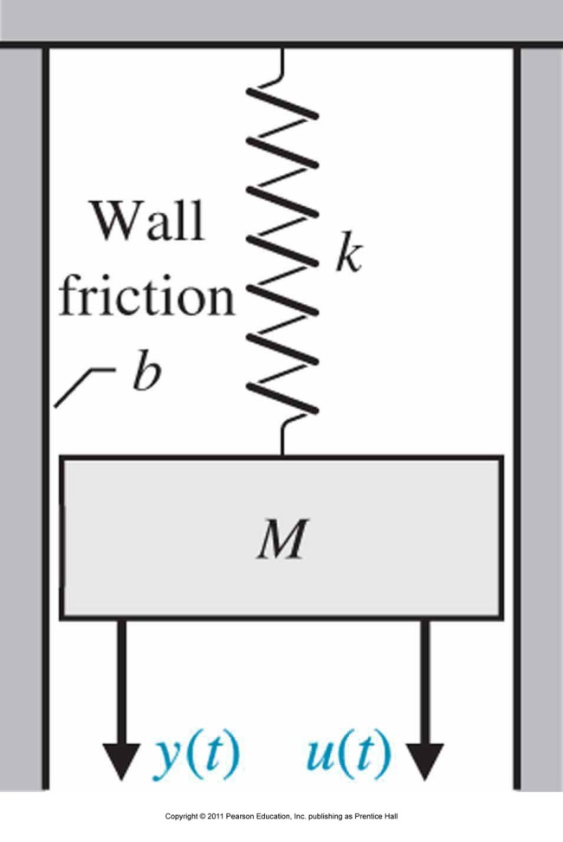
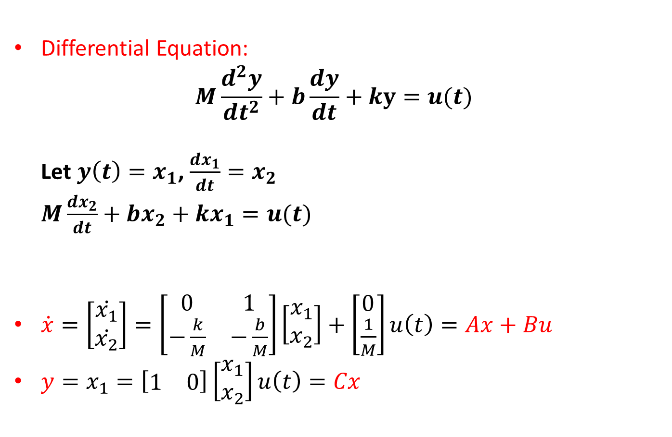
State Differential Equation/Transfer function from State Equation
Differential Equation:
$$M\frac{d^{2}y}{dt^{2}}+b\frac{dy}{dt}+ky=u(t)$$
Let $y\left(t\right)=x_{1}$, $\frac{dx_{1}}{dt}=x_{2}$
$M\frac{dx_{2}}{dt}+bx_{2}+kx_{1}=u(t)$
$\dot{x}=\left[\begin{matrix}\dot{x_{1}} \\ \dot{x_{2}}\end{matrix}\right]=\left[\begin{matrix}0 & 1 \\ −\frac{k}{M} & −\frac{b}{M}\end{matrix}\right]\left[\begin{matrix}x_{1} \\ x_{2}\end{matrix}\right]+\left[\begin{matrix}0 \\ \frac{1}{M}\end{matrix}\right]u\left(t\right)=Ax+Bu$
$y=x_{1}=\left[\begin{matrix}1 & 0\end{matrix}\right]\left[\begin{matrix}x_{1} \\ x_{2}\end{matrix}\right]u\left(t\right)=Cx$

Slide 4
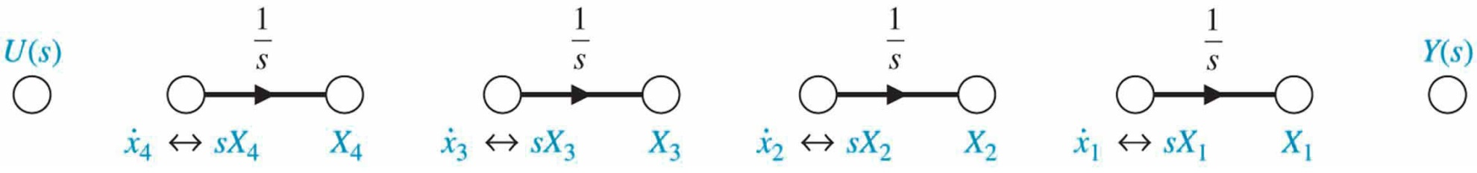
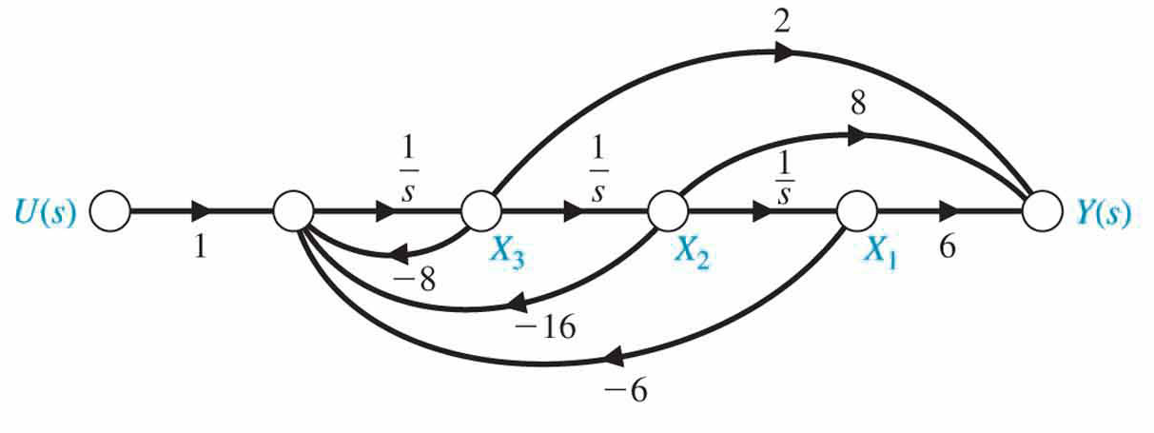
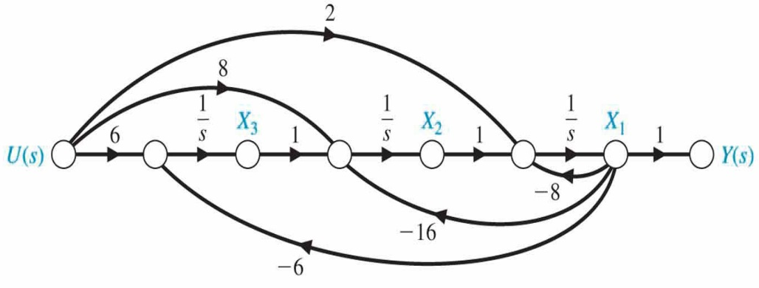
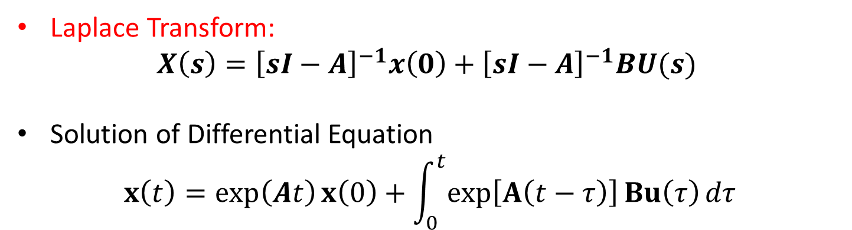
State Differential Equation/Transfer function from State Equation
Laplace Transform:
$$X\left(s\right)={\left[sI−A\right]}^{−1}x\left(0\right)+{\left[sI−A\right]}^{−1}BU(s)$$
Solution of Differential Equation
$$x\left(t\right)=\exp\left(At\right)x\left(0\right)+\int_{0}^{t}{\exp\left[A\left(t−τ\right)\right]Bu\left(τ\right)}dτ$$
Comparison with two Signal Flow
Derive state space eq./Transfer function

Slide 5
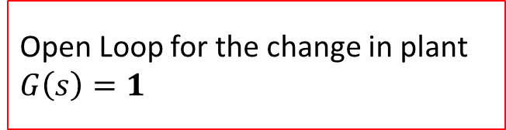
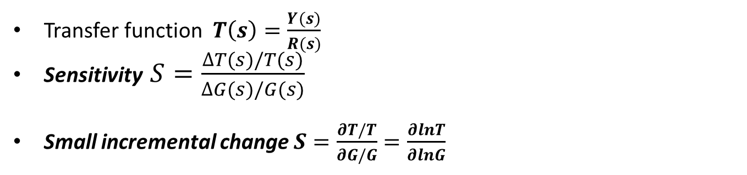
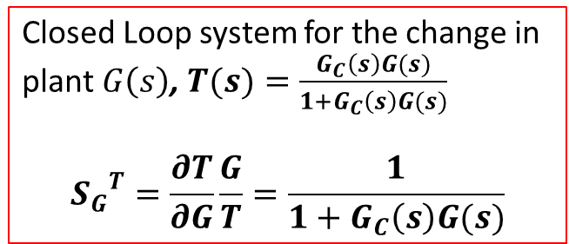
Sensitivity in Feedback Control System
System sensitivity is the ratio of the change in the system transfer function to the change of a process transfer function (or parameter) for a small incremental change
Transfer function $T\left(s\right)=\frac{Y(s)}{R(s)}$
Sensitivity $S=\frac{∆T(s)/T(s)}{∆G(s)/G(s)}$
Small incremental change $S=\frac{∂T/T}{∂G/G}=\frac{∂lnT}{∂lnG}$
Sensitivity in open loop and closed loop
Open Loop for the change in plant $G\left(s\right)=1$
Closed Loop system for the change in plant $G\left(s\right)$, $T(s)=\frac{G_{C}\left(s\right)G(s)}{1+G_{C}\left(s\right)G(s)}$
$${S_{G}}_{}^{T}=\frac{∂T}{∂G}\frac{G}{T}=\frac{1}{1+G_{C}\left(s\right)G(s)}$$

Slide 6
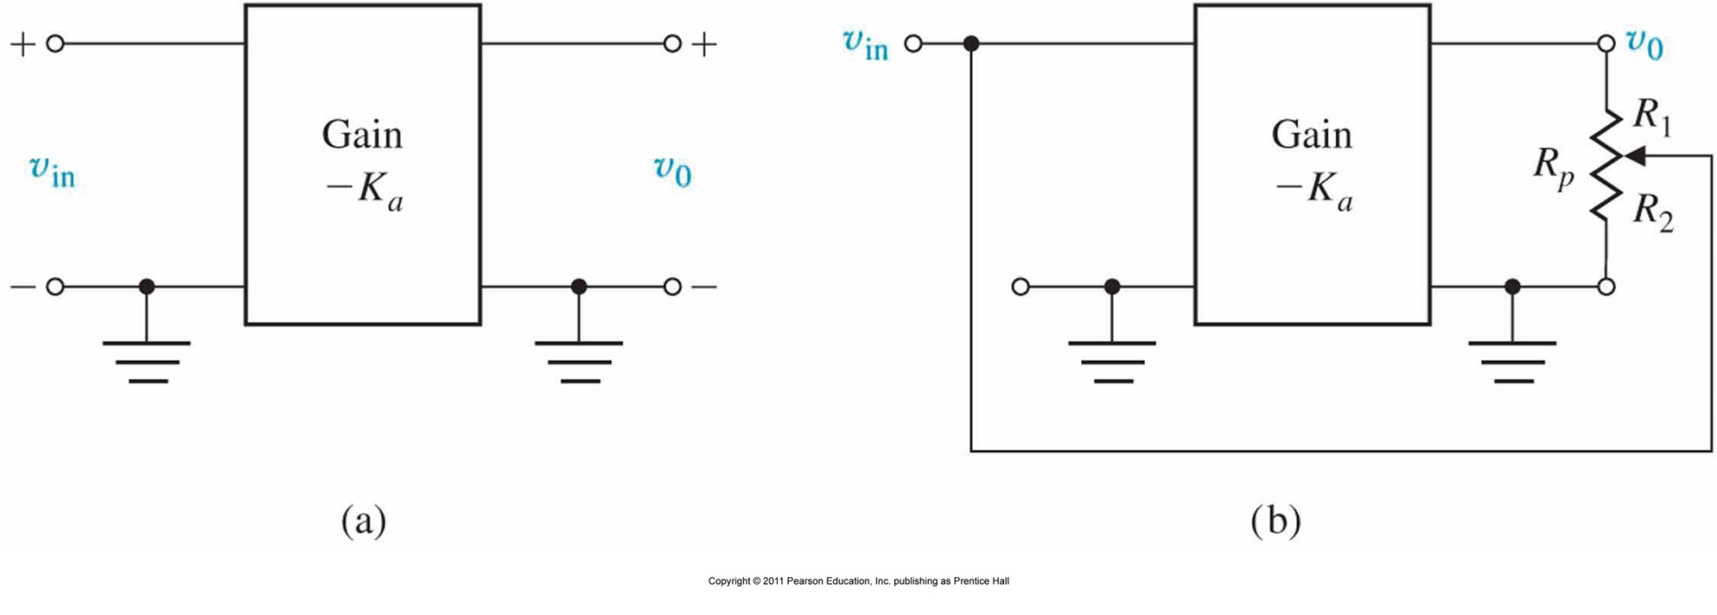
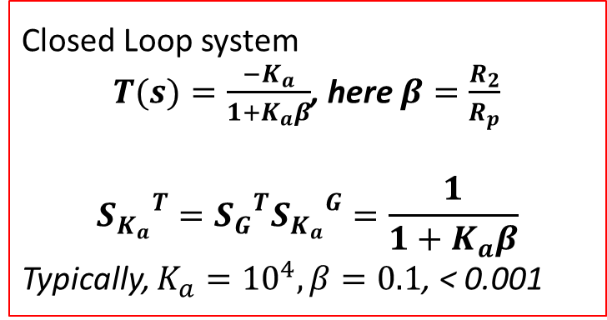
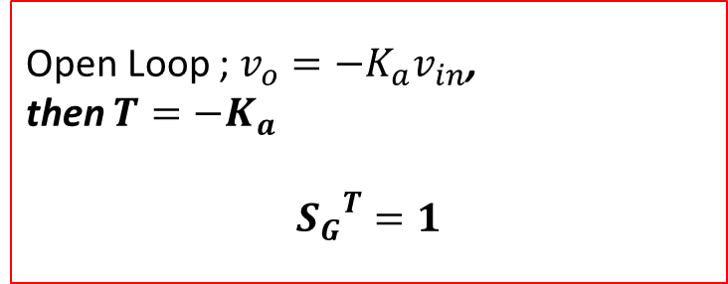
Sensitivity in Feedback Control System
Example
Open Loop ; $v_{o}=−K_{a}v_{in}$,
then $T=−K_{a}$
$${S_{G}}_{}^{T}=1$$
Closed Loop system
$T(s)=\frac{−K_{a}}{1+K_{a}β}$, here $β=\frac{R_{2}}{R_{p}}$
$${S_{K_{a}}}_{}^{T}={S_{G}}_{}^{T}{S_{K_{a}}}_{}^{G}=\frac{1}{1+K_{a}β}$$
Typically, $K_{a}={10}^{4},β=0.1$, < 0.001

Slide 7
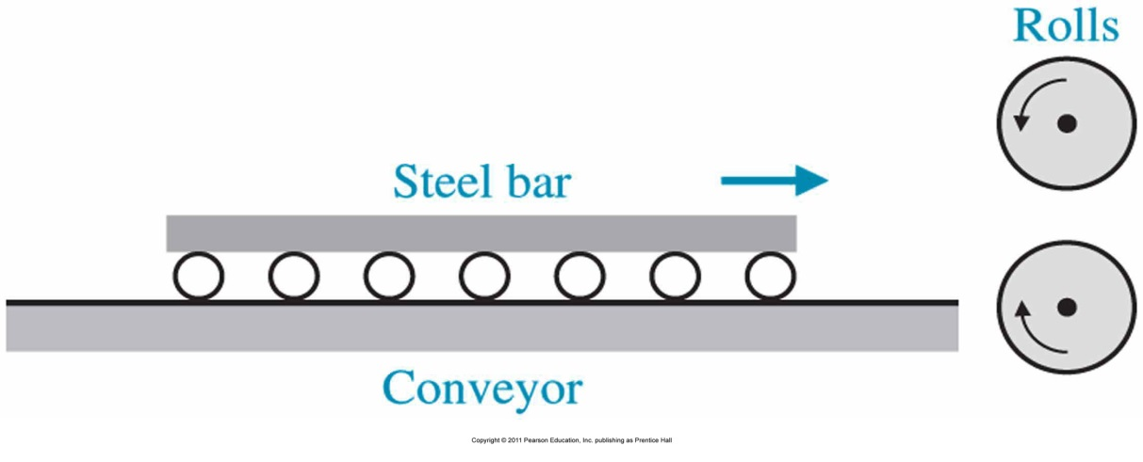
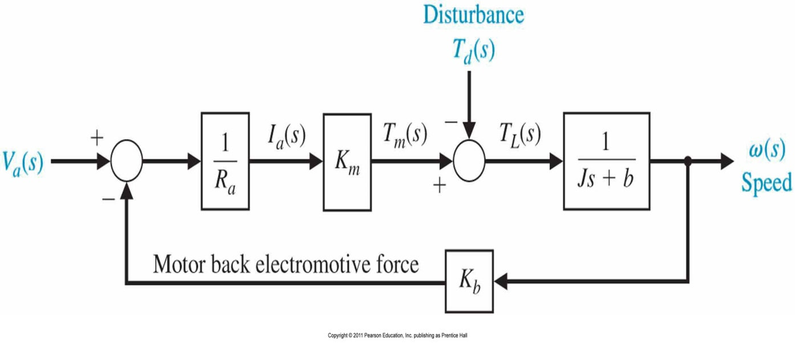
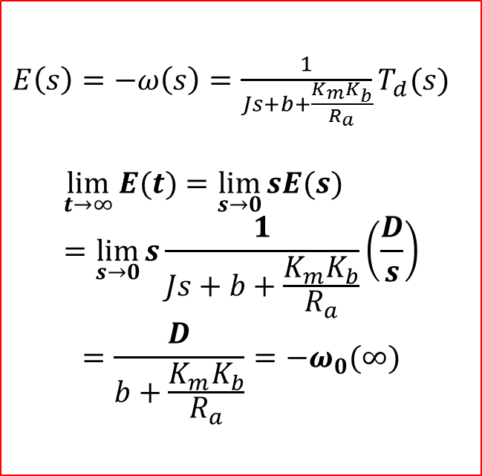
Disturbance Rejection in Feedback Control System
Relation with error and disturbance
$E\left(s\right)=−ω\left(s\right)=\frac{1}{Js+b+\frac{K_{m}K_{b}}{R_{a}}}T_{d}(s)$
$$\lim_{t→∞}{E(t)}=\lim_{s→0}{sE(s)}=\lim_{s→0}{s\frac{1}{Js+b+\frac{K_{m}K_{b}}{R_{a}}}}\left(\frac{D}{s}\right)$$
$$=\frac{D}{b+\frac{K_{m}K_{b}}{R_{a}}}=−ω_{0}(∞)$$

Slide 8
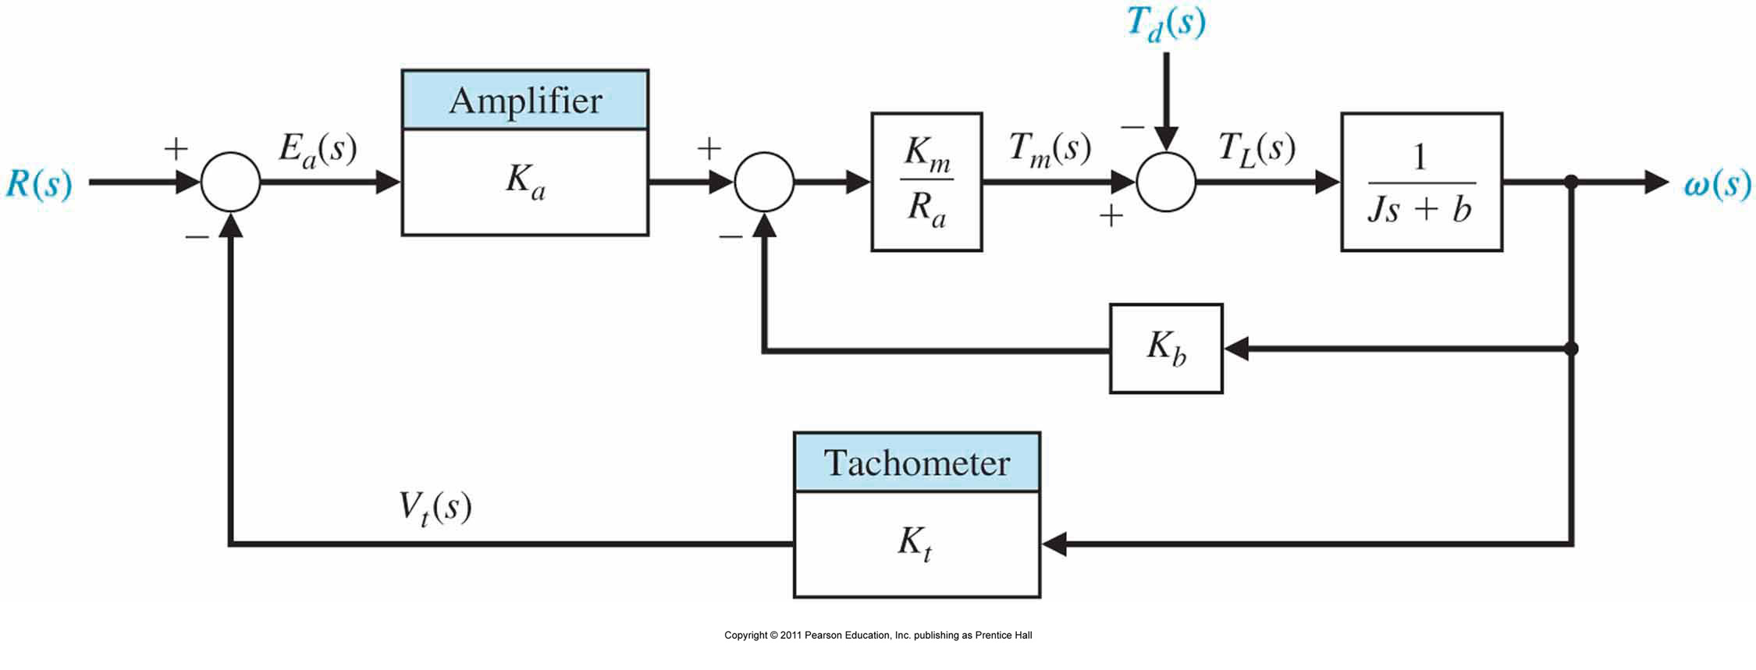
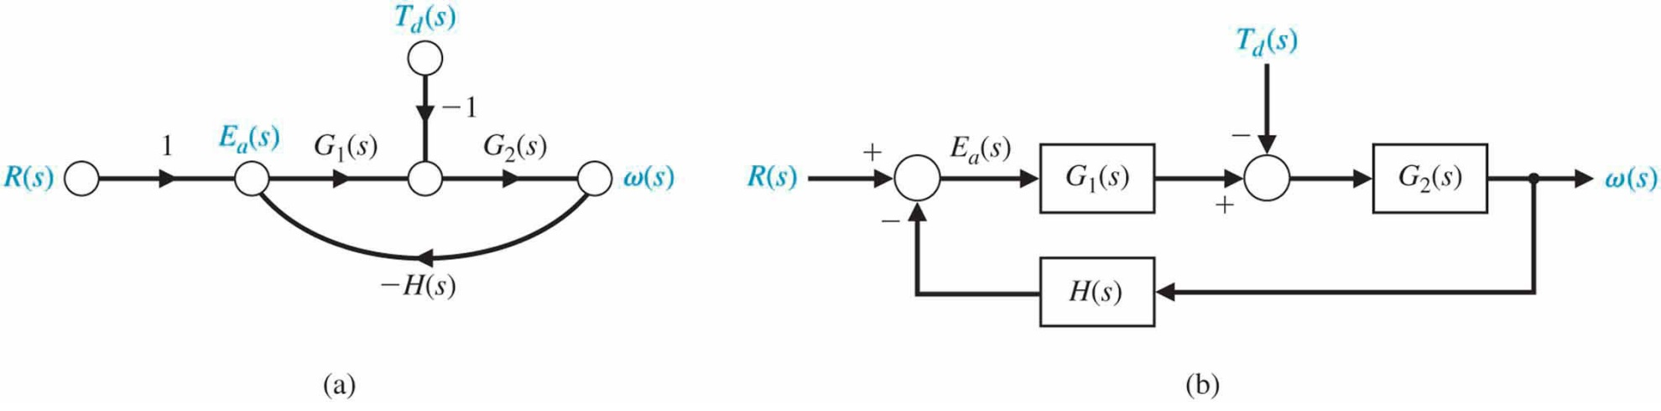
Disturbance Rejection in Feedback Control System
Closed-loop speed tachometer control system
By simplifying

Slide 9

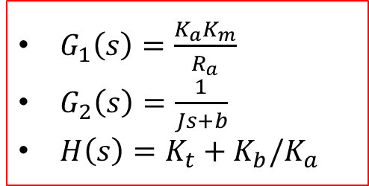
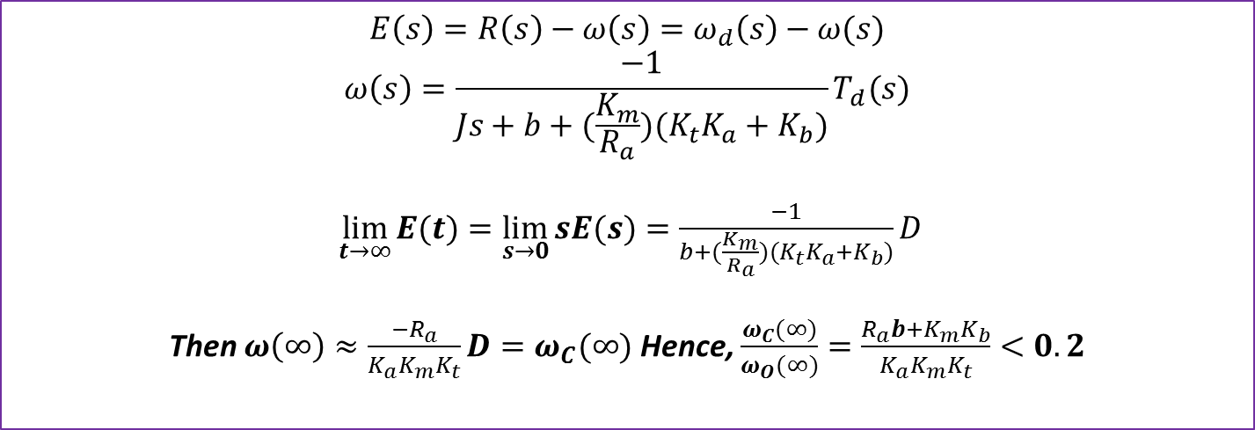
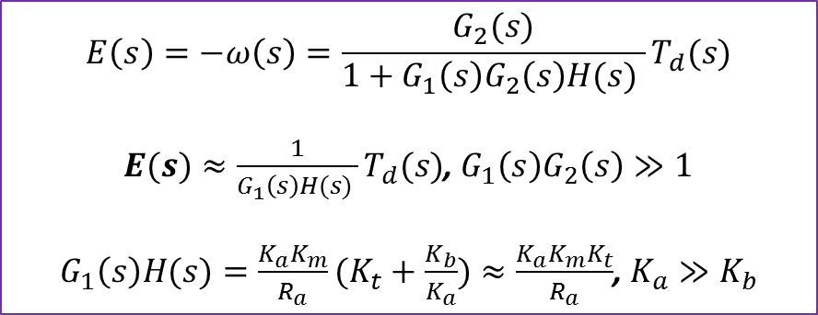
Disturbance Rejection in Feedback Control System
$G_{1}\left(s\right), G_{2}\left(s\right), H(s)$ are summarized
$G_{1}\left(s\right)=\frac{K_{a}K_{m}}{R_{a}}$
$G_{2}\left(s\right)=\frac{1}{Js+b}$
$H\left(s\right)=K_{t}+K_{b}/K_{a}$
$$E\left(s\right)=−ω\left(s\right)=\frac{G_{2}(s)}{1+G_{1}\left(s\right)G_{2}\left(s\right)H(s) }T_{d}(s)$$
$E(s)≈\frac{1}{G_{1}\left(s\right)H(s) }T_{d}(s)$, $G_{1}\left(s\right)G_{2}\left(s\right)≫1$
$G_{1}\left(s\right)H(s)=\frac{K_{a}K_{m}}{R_{a}}(K_{t}+\frac{K_{b}}{K_{a}})≈\frac{K_{a}K_{m}K_{t}}{R_{a}}$, $K_{a}≫K_{b}$
$$E\left(s\right)=R\left(s\right)−ω\left(s\right)=ω_{d}\left(s\right)−ω(s)$$
$$ω\left(s\right)=\frac{−1}{Js+b+(\frac{K_{m}}{R_{a}})(K_{t}K_{a}+K_{b})}T_{d}(s)$$
$\lim_{t→∞}{E(t)}=\lim_{s→0}{sE(s)}=\frac{−1}{b+(\frac{K_{m}}{R_{a}})(K_{t}K_{a}+K_{b})}D$
Then $ω\left(∞\right)≈\frac{{−R}_{a}}{K_{a}K_{m}K_{t}}D=ω_{C}(∞)$ Hence, $\frac{ω_{C}(∞)}{ω_{O}(∞)}=\frac{R_{a}b+K_{m}K_{b}}{K_{a}K_{m}K_{t}}<0.2$

Slide 10
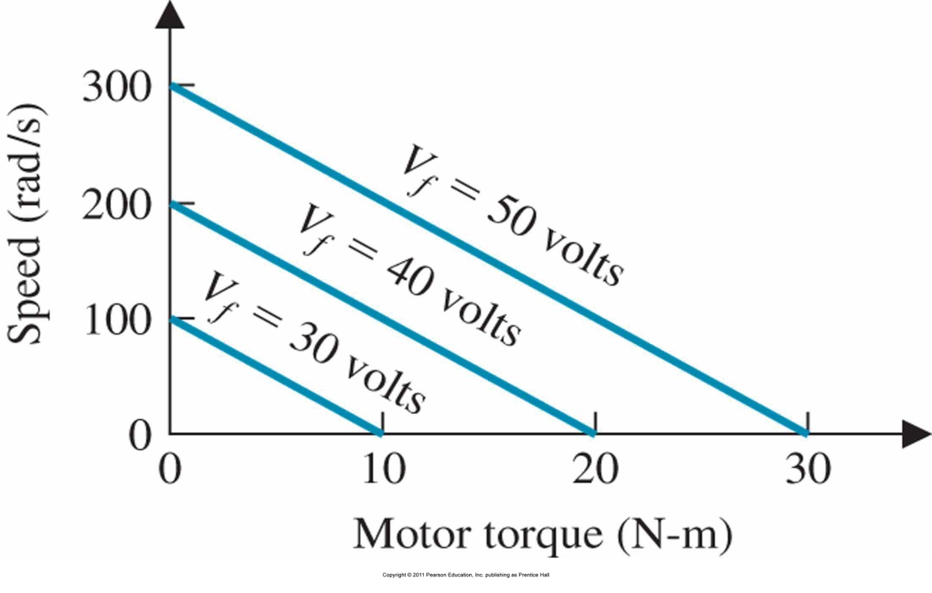
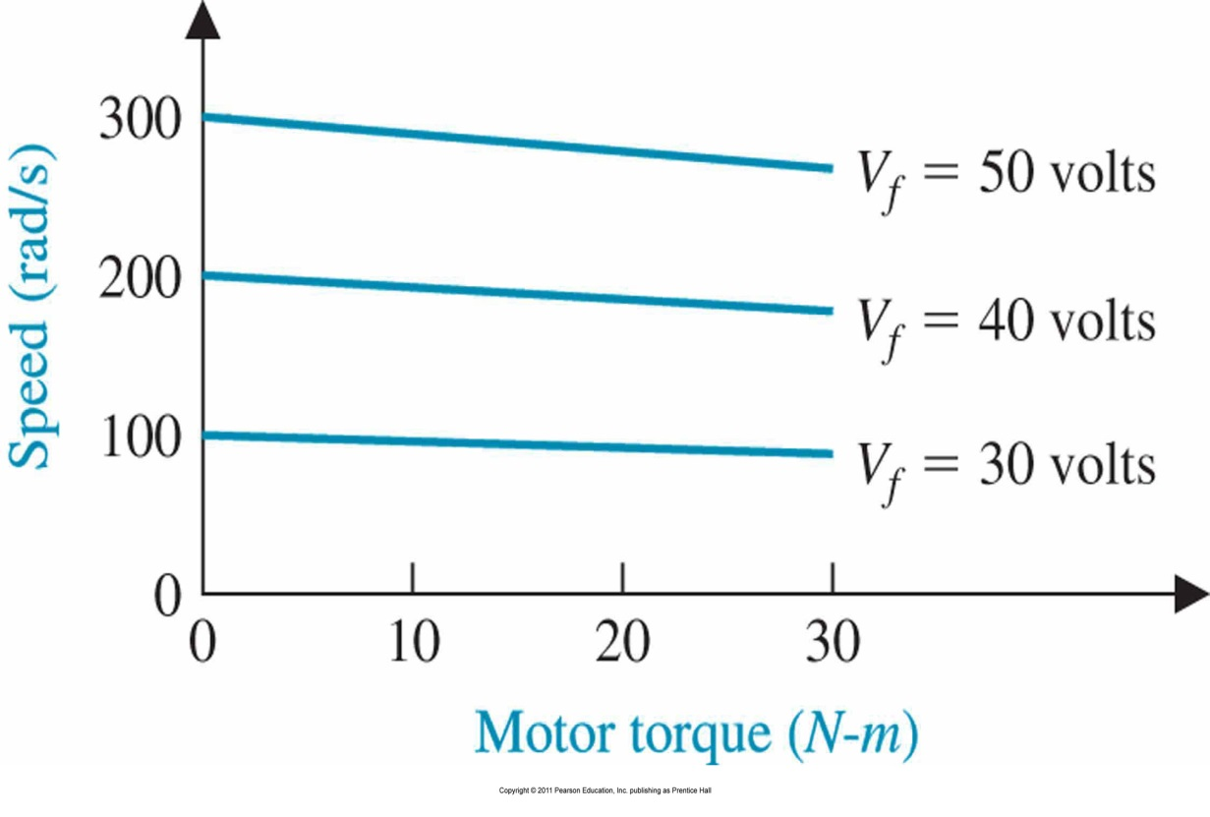
Comparison with open loop and closed loop Structure
Motor speed-torque curves
-Open loop
Motor speed-torque curves
-Closed loop

Slide 11
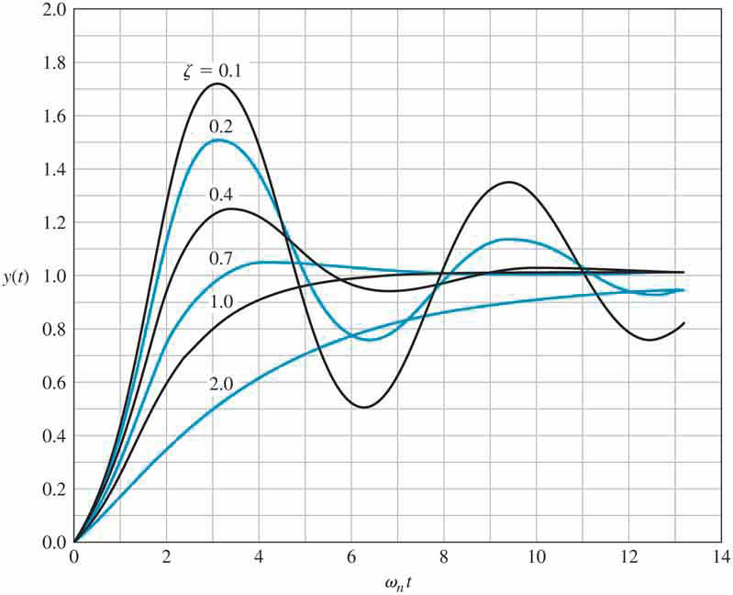
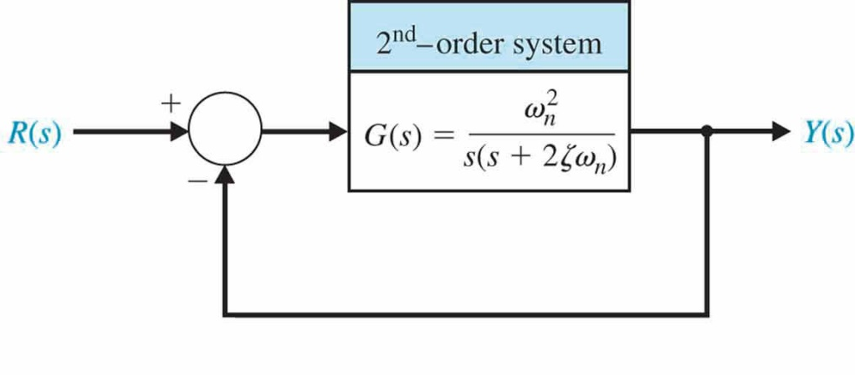
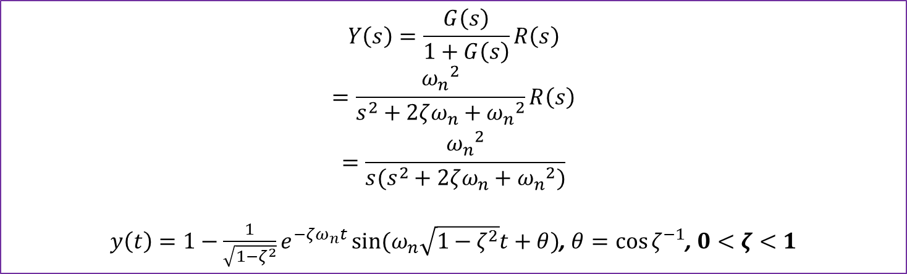
Performance of Second Order Systems
$$Y\left(s\right)=\frac{G\left(s\right)}{1+G\left(s\right)}R\left(s\right)$$
$$=\frac{{ω_{n}}_{}^{2}}{s^{2}+2ζω_{n}+{ω_{n}}_{}^{2}}R\left(s\right)$$
$$=\frac{{ω_{n}}_{}^{2}}{s(s^{2}+2ζω_{n}+{ω_{n}}_{}^{2})}$$
$y\left(t\right)=1−\frac{1}{\sqrt{1−ζ^{2}}}e^{−ζω_{n}t}\sin{(ω_{n}\sqrt{1−ζ^{2}}t+θ)}$, $θ={\cos{ζ}}^{−1}$, $0<ζ<1$

Slide 12
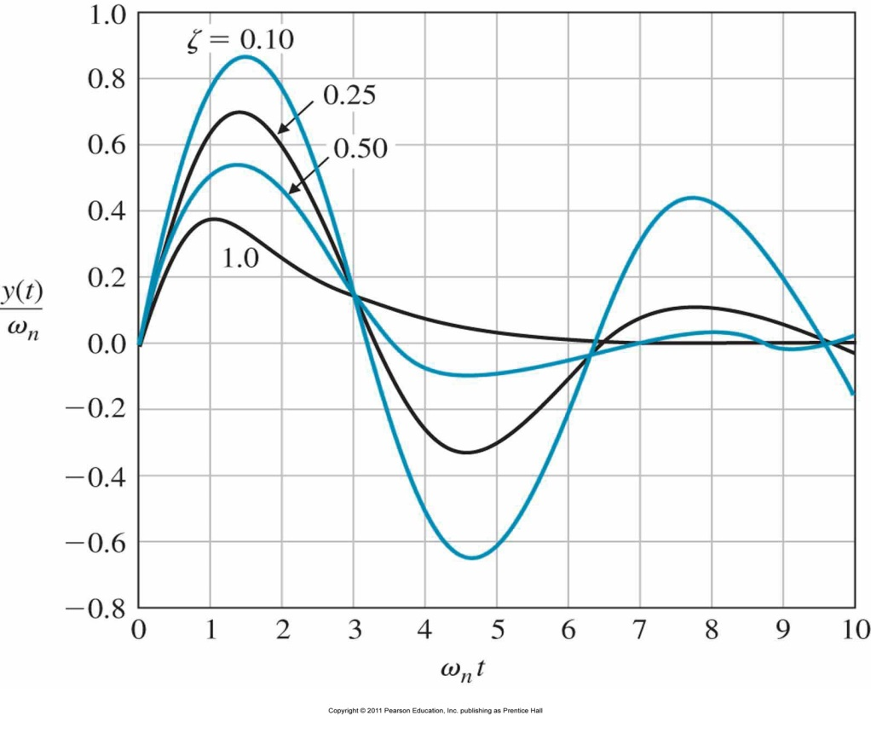
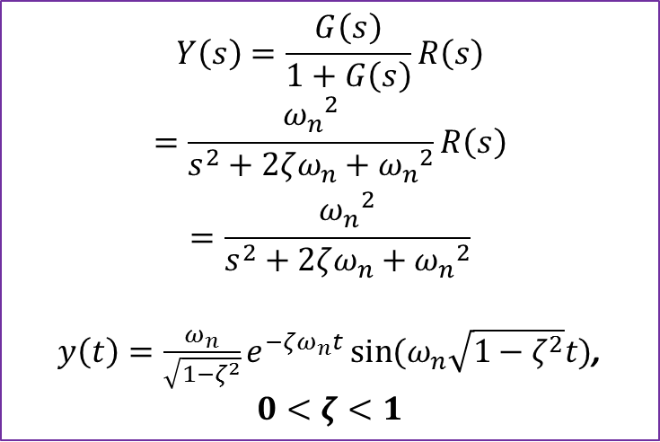
Performance of Second Order Systems; impulse response
$$Y\left(s\right)=\frac{G\left(s\right)}{1+G\left(s\right)}R\left(s\right)$$
$$=\frac{{ω_{n}}_{}^{2}}{s^{2}+2ζω_{n}+{ω_{n}}_{}^{2}}R\left(s\right)$$
$$=\frac{{ω_{n}}_{}^{2}}{s^{2}+2ζω_{n}+{ω_{n}}_{}^{2}}$$
$y\left(t\right)=\frac{ω_{n}}{\sqrt{1−ζ^{2}}}e^{−ζω_{n}t}\sin{(ω_{n}\sqrt{1−ζ^{2}}t)}$, $0<ζ<1$

Slide 13
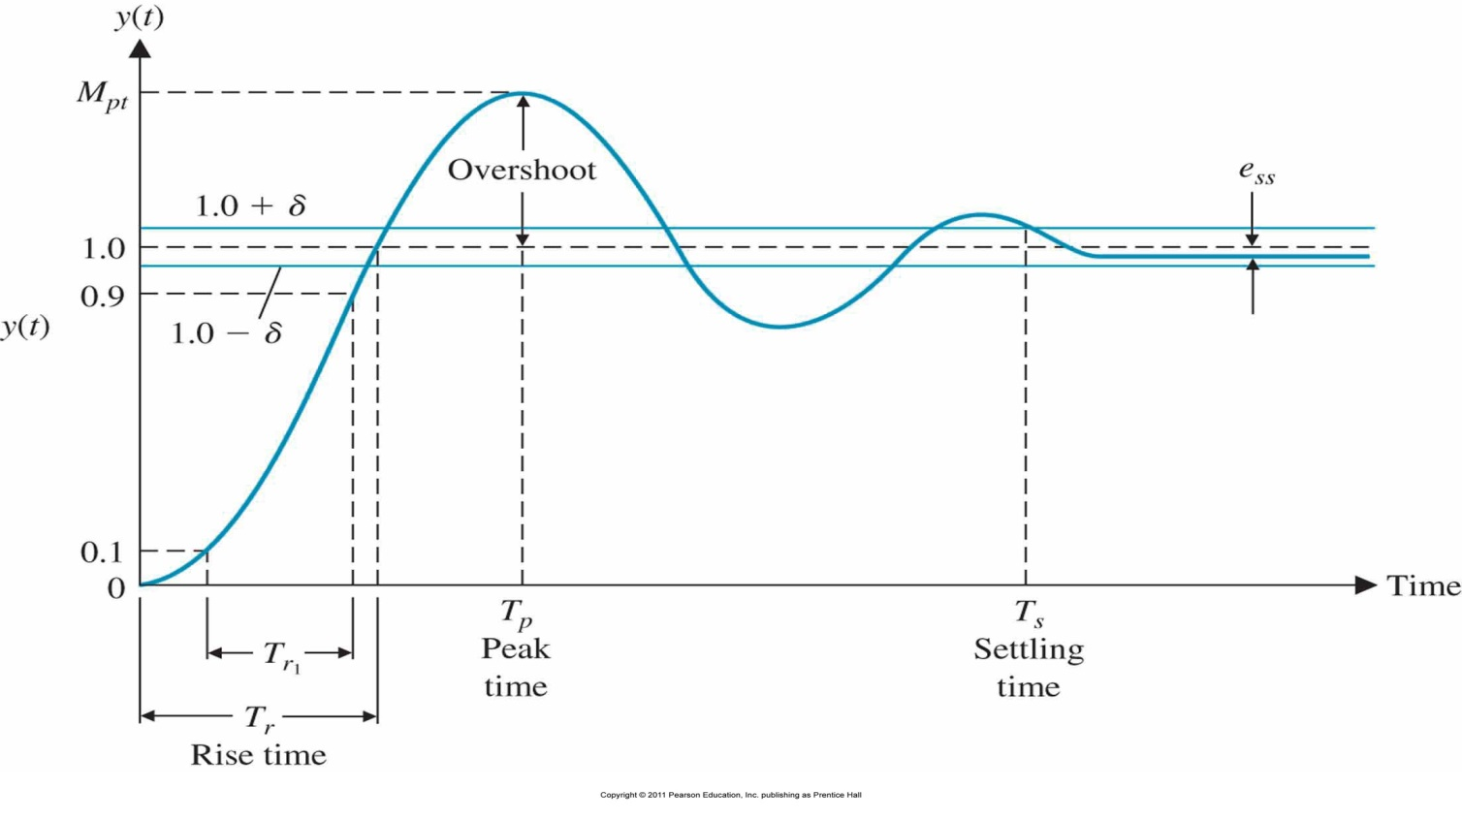
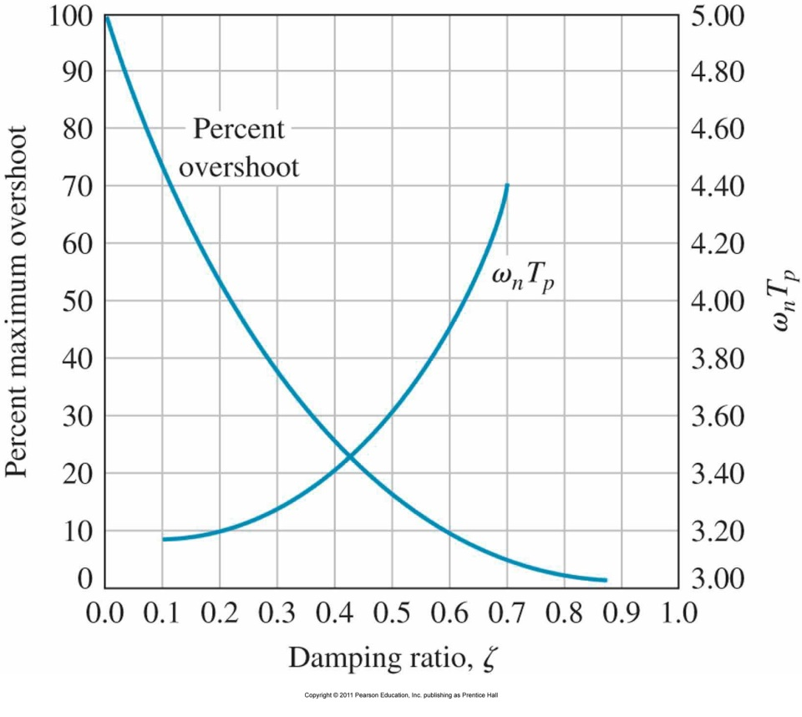
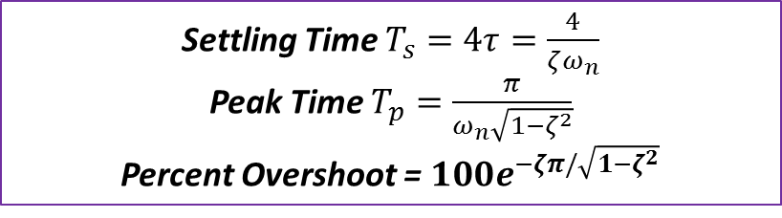
Performance of Second Order Systems
Settling Time $T_{s}=4τ=\frac{4}{ζω_{n}}$
Peak Time $T_{p}=\frac{π}{ω_{n}\sqrt{1−ζ^{2}}}$
Percent Overshoot = $100e^{−ζπ/\sqrt{1−ζ^{2}}}$

Slide 14
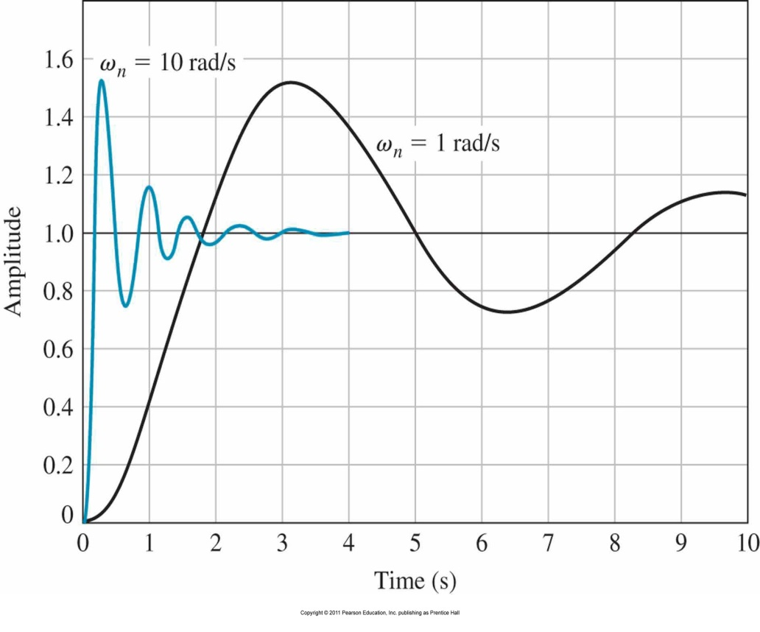
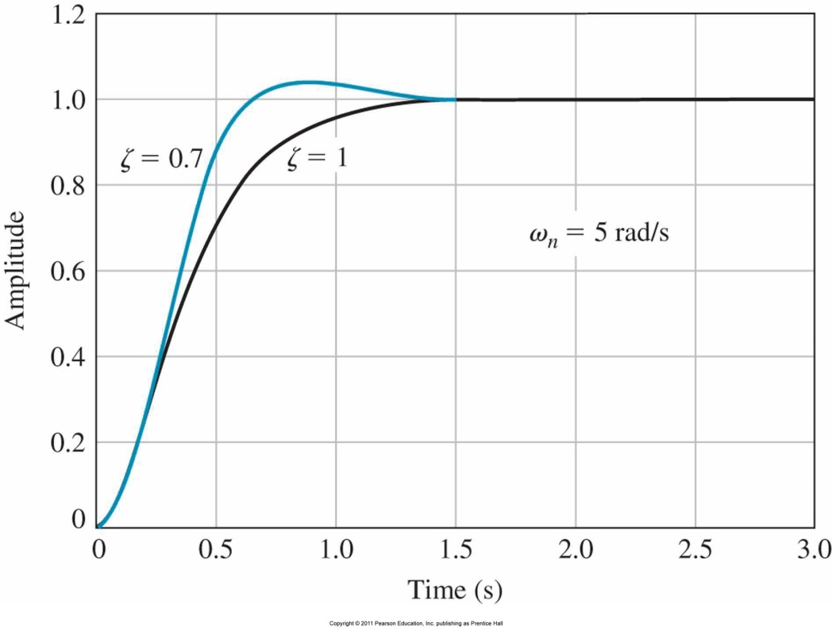
Performance of Second Order Systems
The step response for ζ = 0.2 for ω_{n} = 1 and ω_{n} = 10
The step response for ω_{n} = 5 with ζ = 0.7 and ζ = 1.

Slide 15
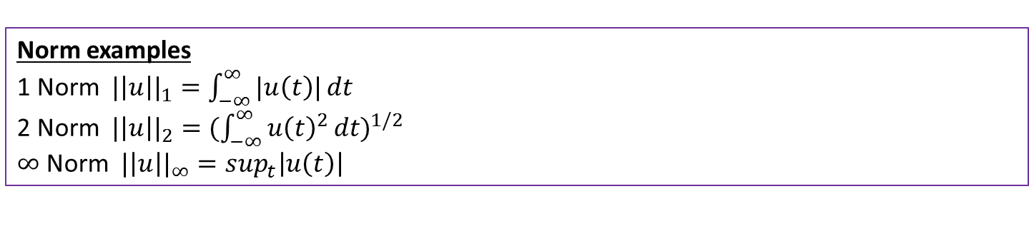
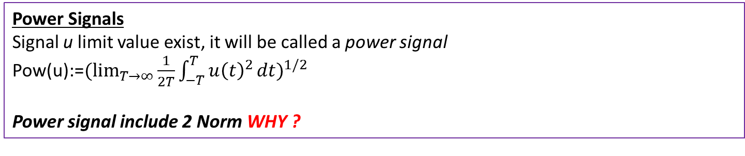
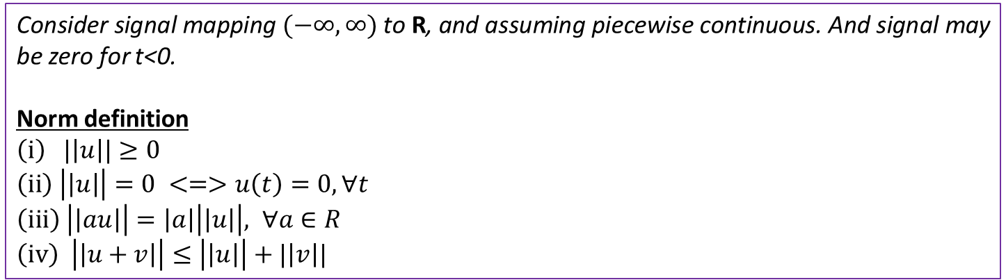
Norms for Signals and Systems
Consider signal mapping $(−∞, ∞)$ to R, and assuming piecewise continuous. And signal may be zero for t<0.
Norm definition
$\left(i\right) |\left|u\right||≥0$
$$\left(ii\right) \left|\left|u\right|\right|=0 <=>u\left(t\right)=0, ∀t$$
$\left(iii\right) \left|\left|au\right|\right|=\left|a\right|\left|\left|u\right|\right|, ∀a∈R$
$\left(iv\right) \left|\left|u+v\right|\right|≤\left|\left|u\right|\right|+|\left|v\right||$
Norm examples
1 Norm ${|\left|u\right||}_{1}=\int_{−∞}^{∞}{|u\left(t\right)|}dt$
2 Norm ${|\left|u\right||}_{2}={(\int_{−∞}^{∞}{{u\left(t\right)}^{2}}dt)}^{1/2}$
$∞$ Norm ${|\left|u\right||}_{∞}=\sup_{t}\left|u\left(t\right)\right|$
Power Signals
Signal u limit value exist, it will be called a power signal
Pow(u):=${(\lim_{T→∞}{\frac{1}{2T}}\int_{−T}^{T}{{u\left(t\right)}^{2}}dt)}^{1/2}$
Power signal include 2 Norm WHY ?

Slide 16
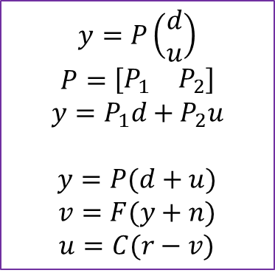
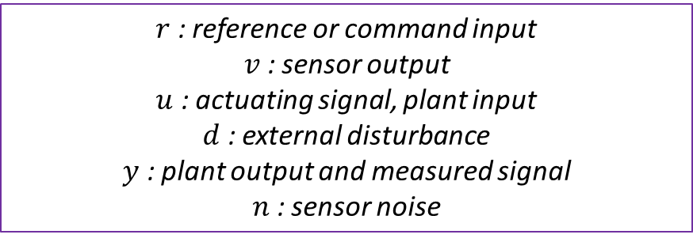
Elementary Feedback System
d
r
u
y
Controller: C
Plant: P
v
Sensor: F
n
$$y=P\left(\begin{matrix}d \\ u\end{matrix}\right)$$
$$P=\left[\begin{matrix}P_{1} & P_{2}\end{matrix}\right]$$
$$y=P_{1}d+P_{2}u$$
$y=P(d+u)$ $v=F(y+n)$ $u=C(r−v)$
$r$ : reference or command input
$v$ : sensor output
$u$ : actuating signal, plant input
$d$ : external disturbance
$y$ : plant output and measured signal
$n$ : sensor noise

Slide 17
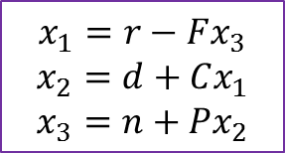
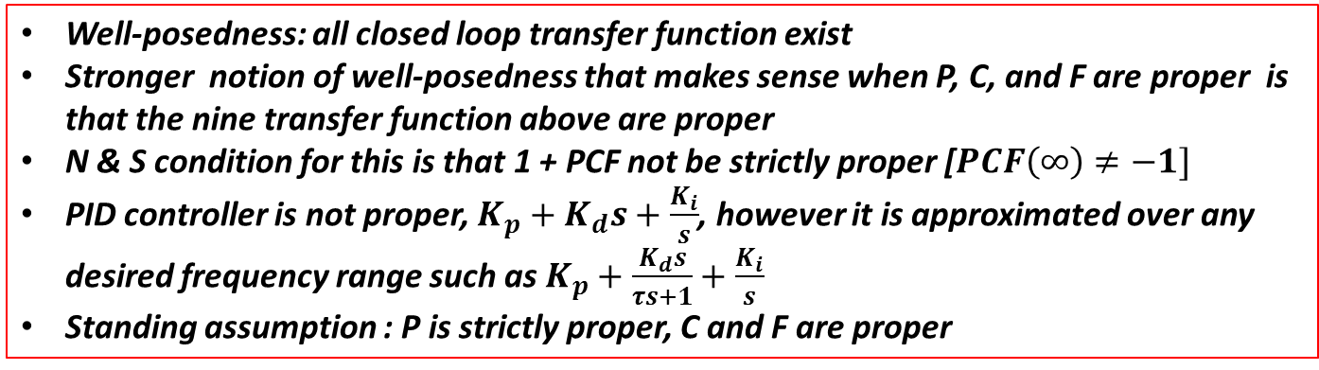
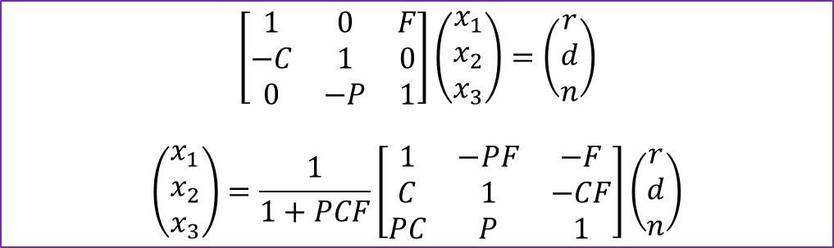
Basic Feedback Loop
d
r
x₁
u
x₂
y
C
P
-
v
x₃
F
n
$$\left[\begin{matrix}1 & 0 & F \\ −C & 1 & 0 \\ 0 & −P & 1\end{matrix}\right]\left(\begin{matrix}x_{1} \\ x_{2} \\ x_{3}\end{matrix}\right)=\left(\begin{matrix}r \\ d \\ n\end{matrix}\right)$$
$$\left(\begin{matrix}x_{1} \\ x_{2} \\ x_{3}\end{matrix}\right)=\frac{1}{1+PCF}\left[\begin{matrix}1 & −PF & −F \\ C & 1 & −CF \\ PC & P & 1\end{matrix}\right]\left(\begin{matrix}r \\ d \\ n\end{matrix}\right)$$
$$x_{1}=r−Fx_{3}$$
$$x_{2}=d+Cx_{1}$$
$$x_{3}=n+Px_{2}$$
Well-posedness: all closed loop transfer function exist
Stronger notion of well-posedness that makes sense when P, C, and F are proper is that the nine transfer function above are proper
N & S condition for this is that 1 + PCF not be strictly proper [$PCF\left(∞\right)≠−1]$
PID controller is not proper, $K_{p}+K_{d}s+\frac{K_{i}}{s}$, however it is approximated over any desired frequency range such as $K_{p}+\frac{K_{d}s}{τs+1}+\frac{K_{i}}{s}$
Standing assumption : P is strictly proper, C and F are proper

Slide 18
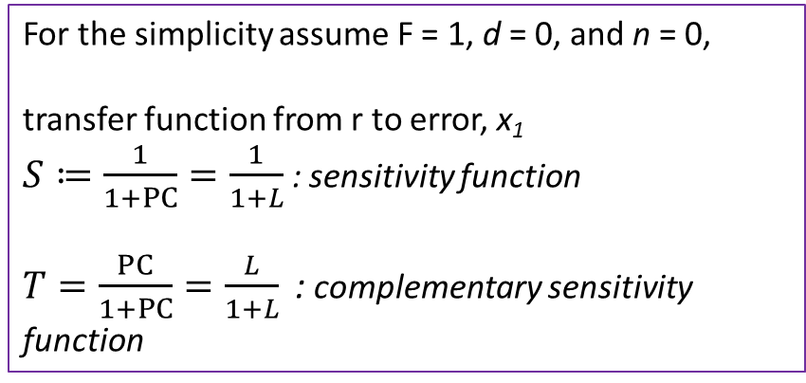
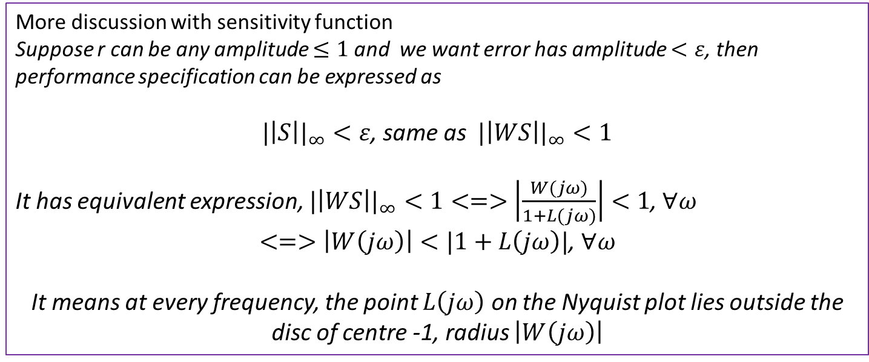
Performance and Sensitivity
d
For the simplicity assume F = 1, d = 0, and n = 0,
transfer function from r to error, x₁
$S≔\frac{1}{1+PC}=\frac{1}{1+L}$ : sensitivity function
$T=\frac{PC}{1+PC}=\frac{L}{1+L}\text{ :}$ complementary sensitivity function
r
x₁
u
x₂
y
C
P
-
v
x₃
n
F
More discussion with sensitivity function
Suppose r can be any amplitude $≤1$ and we want error has amplitude $<ε$, then performance specification can be expressed as
${|\left|S\right||}_{∞}<ε$, same as ${|\left|WS\right||}_{∞}<1$
It has equivalent expression, ${|\left|WS\right||}_{∞}<1<=>$ $\left|\frac{W(jω)}{1+L(jω)}\right|<1$, $∀ω$
$<=>\left|W\left(jω\right)\right|<|1+L\left(jω\right)|$, $∀ω$
It means at every frequency, the point $L\left(jω\right)$ on the Nyquist plot lies outside the disc of centre -1, radius $\left|W\left(jω\right)\right|$

Slide 19
End of Lecture
Properties of Feedback System - Lecture 3
Instructor: Sanghyuk Lee
Sanghyuk.Lee@xjtlu.edu.cn
Tel: 8816-1415
Department of Electrical and Electronic Engineering
XJTLU

